Slide 1
Station 1
While having fun in Chemistry class, you get your hands dirty doing a lab. You wash your hands using one of the
sinks. You rinse for 2 seconds.
(Fill the beaker with water for about 2 seconds, you may count out loud.)
Use the balance (after zeroing/ taring with an empty beaker) to weigh the water (but not the beaker) in grams.
a. Assuming it is pure water, how many molecules of water did you use to rinse your hands?
b. How many total atoms did you use?

Slide 2
Station 2
After doing all of these chemistry calculations, you are hungry. You decide to have a bag of chips. Do not actually
eat the chips!
a. How many moles of sodium (NaCl) did you just consume after eating the entire bag?
b. How many atoms of sodium did you consume?

Slide 3
Station 3
Doing the chemistry problems is now making you thirsty. You decide that you should have a can of soda.
a. How many moles of sugar (C₁₂H₂₂O₁₁) did you just consume?
b. How many molecules of sugar did you just consume?
*Bonus: What is the molecular structure of this sugar molecule?

Slide 4
Station 4
A chef finds a new recipe that calls for 2 spoonfuls of sodium chloride.
a. How many moles of sodium chloride did she use?
b. How many formula units of sodium chloride did she use?
c. How many total atoms of sodium and chlorine are in the recipe?

Slide 5
Station 5
After eating a bunch of junk food, you decide to have a (semi-healthy) granola bar.
a. How many moles of potassium are in your granola bar?
b. How many atoms of potassium would you consume if you ate the whole package?

Slide 6
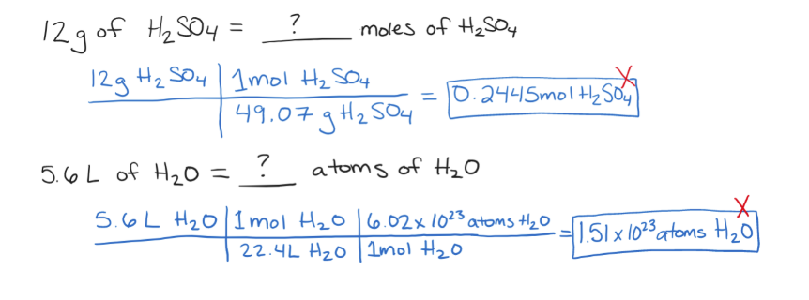
Station 6
Each of the problems below contains an error. The black font is the question, the blue font is the student
work, marked wrong with a red X. Identify the mistake and provide a sentence explanation of how to
correct the problem.

Slide 7
Station 7
Create and solve a stoichiometry test question.
1. Write a problem converting from one unit to another (ex: mass to molecules)
2. Show how to solve the problem (using dimensional analysis – be sure to cancel units!)
3. Box your answer.
4. Swap your problem with a partner in your group to check that the question makes sense.

