Slide 1


Effect of Temperature on Pressure & Volume of a gas
Simulation Lab
Name:

Slide 2
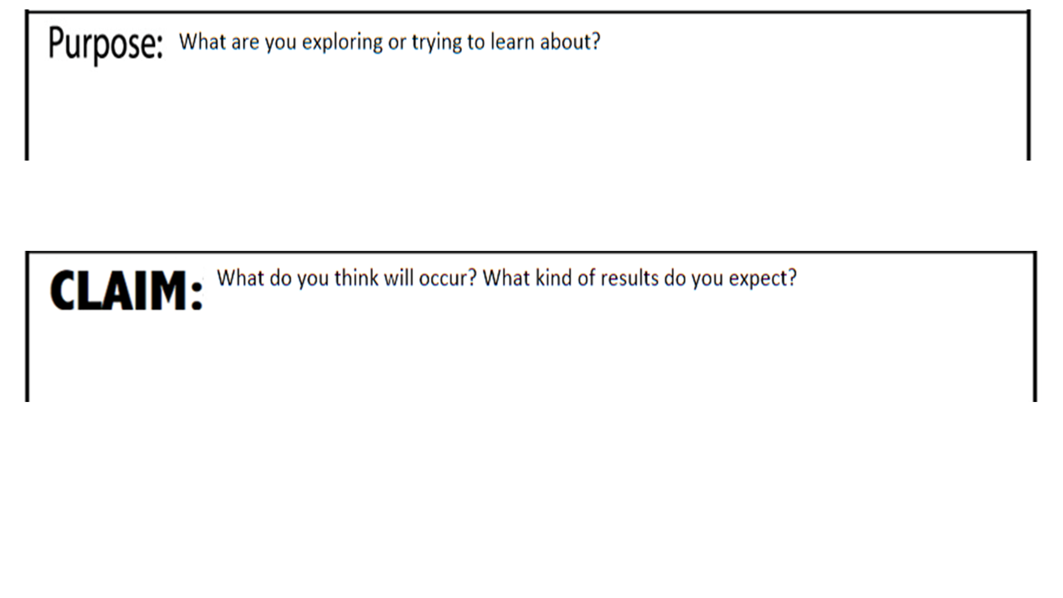
How does temperature, pressure, and volume affect a given quantity of a gas?
What do you think will happen to a gas in a container if you change the temperature, the pressure and the volume?

Slide 3
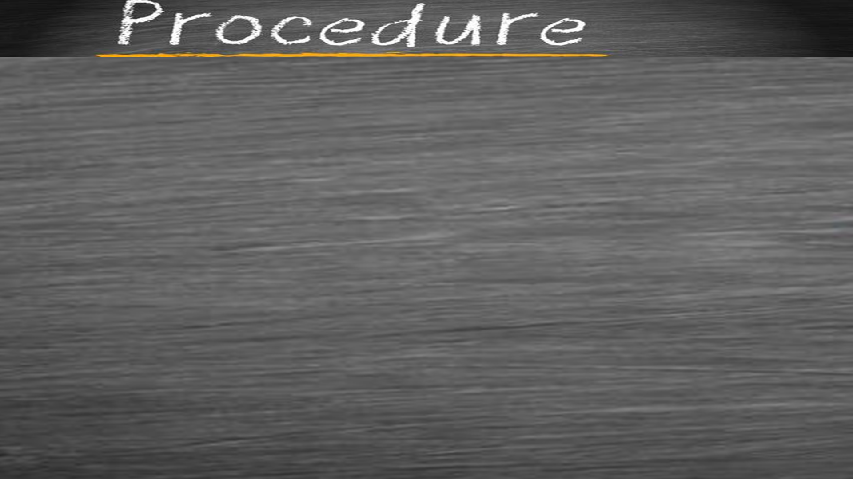

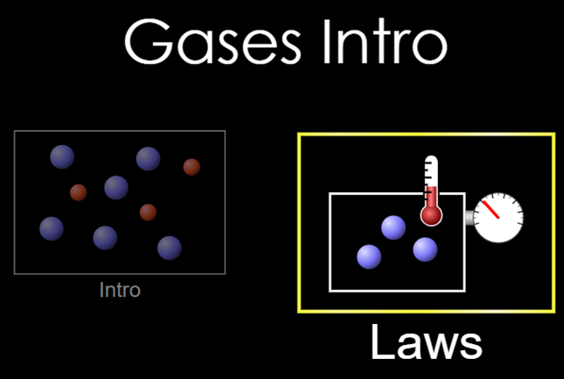
1)
Watch the video
Watch the video
Go to the simulation through the link: https://phet.colorado.edu/sims/html/gases-intro/latest/gases-intro_en.html
Choose the Laws option on the right
Give one pump of gas into the chamber.
Choose to hold the volume constant by selecting that option in the upper right-hand corner.
Record the initial temperature (in K) and pressure (in atm) in the chamber in the table below.
Use the slider at the bottom of the simulator to add heat and raise the temperature by 100 K. Record your results in the table.
Repeat step (7) above 3 times and record your data.
Graph your data. Use a line graph. Paste your graph to the right.
Which gas law does the data represent?
Paste Line Graph below
Describe the graph and relationship:
Temperature K | Pressure atm
Answer:

Slide 4
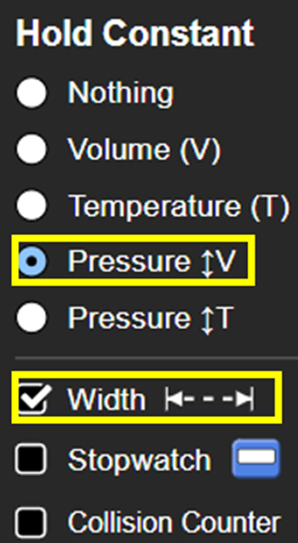

2)
Watch the video
Watch the video
Reset the simulator by selecting the reset button in the bottom right corner
Give one pump of gas into the chamber.
Choose to hold the pressure constant. Also select Width.
Record the initial temperature (in K) and volume (in nm³) in the chamber in the table below.
Use the slider at the bottom of the simulator to add some heat and raise the temperature by 50K.. Record your results for temperature & volume in the table.
Repeat step (6) above 3 times by adding arising the temperature by 50K each time and record your data.
Graph your data. Use a line graph. Paste your graph to the right.
Which gas law does the data represent?
Paste Line Graph below
Describe the graph and relationship:
Temperature K | Volume nm³
Answer:

Slide 5
