Slide 1

Redox Titration Practical
Iodometric Titration

Slide 2
The Setup
5 cm³ H₂O₂ was combined with 20 cm³ 10% KI, 10 cm³ of 3 mol dm⁻³ H₂SO₄, and filled to 100 cm³ in a volumetric flask with distilled H₂O.
The solution was let stand for 10 minutes.
Write the redox reaction that occurs when the solution is mixed.
What were the products of this reaction?

Slide 3
The Titration
20 cm³ of the sample was removed and placed in a 125 cm³ Erlenmeyer flask. This will be titrated with 0.1 mol dm⁻³ sodium thiosulfate.
Write the redox reaction that occurs during the titration.

Slide 4
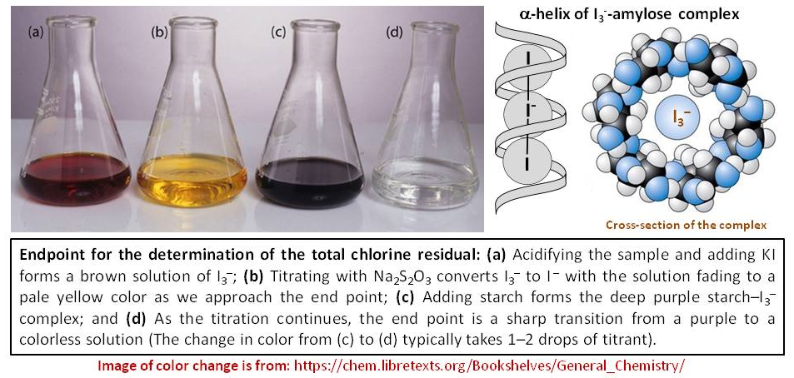
The indicator
Often, redox titrations are their own indicators.
However, in iodometric titrations, starch is often used near the endpoint.

Slide 5

Your Objective
Determine the concentration of hydrogen peroxide in the original solution.

Slide 6
Group Contributions
Group Number | Calculation | Result
1 | Average Titre of Na₂S₂O₃ (with absolute uncertainty) | ^{11.50 ± 1.0 cm^3}
2 | Moles Na₂S₂O₃ to reach end-point | 0.00115 mol
3 | Moles H₂O₂ in titrated flask | 0.0364 mol
4 | Moles H₂O₂ in original sample | 0.182 mol
5 | Concentration H₂O₂ in original sample | 0.88 mol dm^-3
6 | Grams H₂O₂ in original sample | 0.15 g
7 | % (w/v) H₂O₂ | 3.0%

