Slide 1
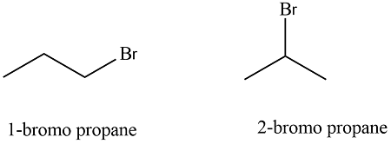
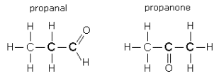
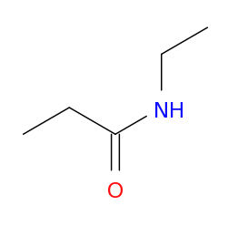
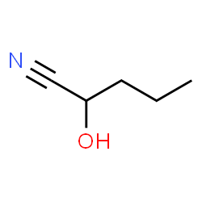
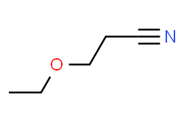
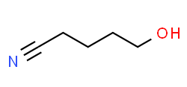
C₃H₇Br
C₂H₅CHO
C₅H₉NO
5-hydroxy-pentanenitrile
3-ethoxypropionitrile
2-hydroxy-pentanenitrile
N-ethyl-propanamide

Slide 2
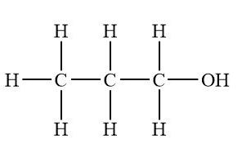
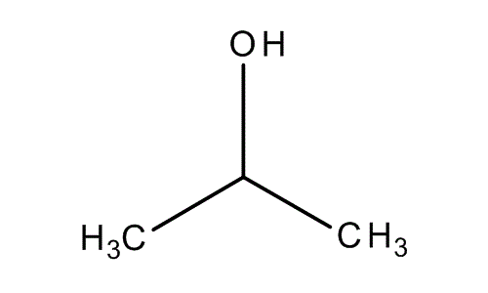
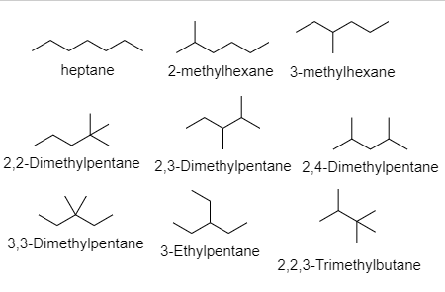
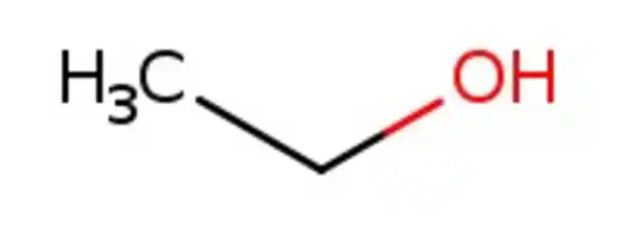
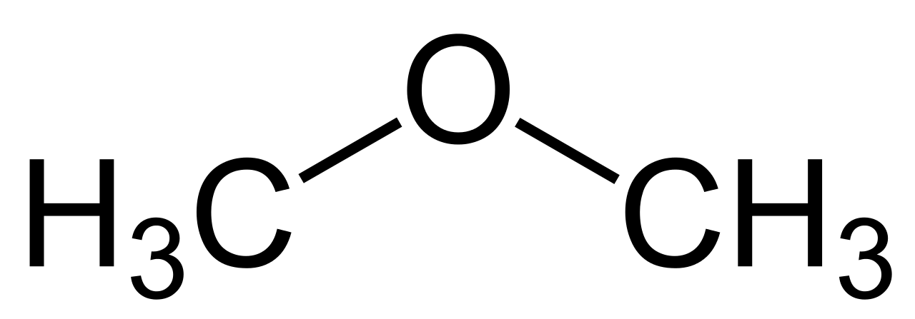
C₃H₇OH
C₇H₁₆
1-propanol
2-propanol
CH₃CH₂OH
1-ethanol
methoxymethane

Slide 3
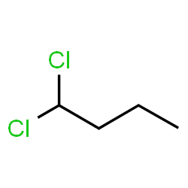
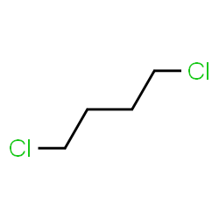
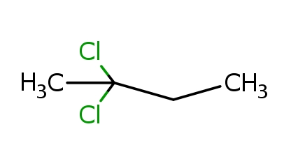
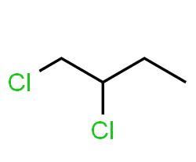
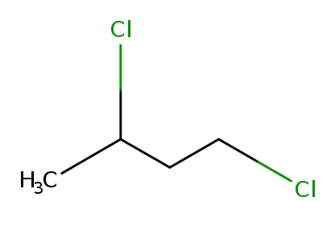
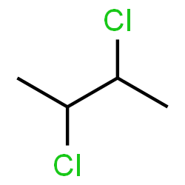
C₄H₈Cl₂
1,1-dichlorobutane
1,4-dichlorobutane
2,2-dichlorobutane
2,3-dichlorobutane
1,2-dichlorobutane
1,3-dichlorobutane

Slide 4
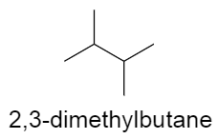
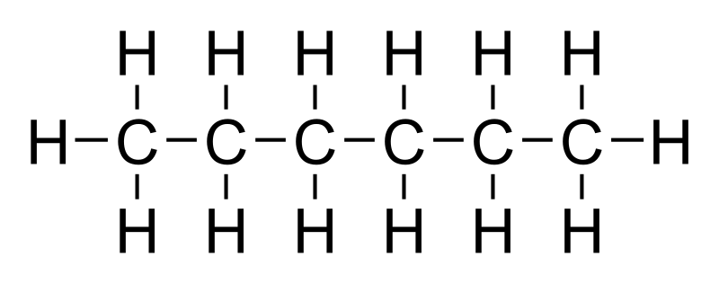
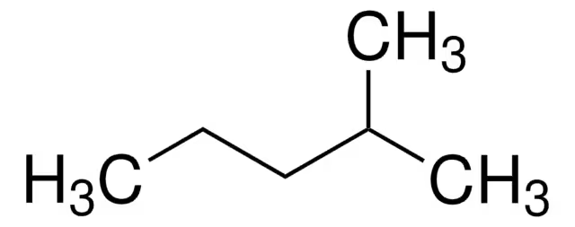
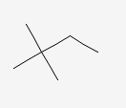
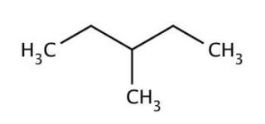
(CH₃)₂CHCH(CH₃)₂
hexane
2-methylpentane
2,2-dimethylbutane
3-methylpentane

Slide 5
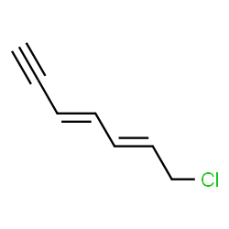
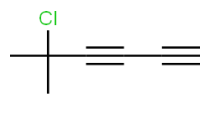
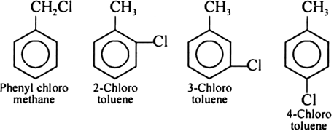
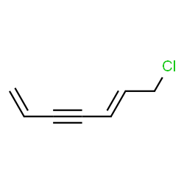
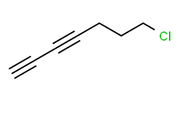
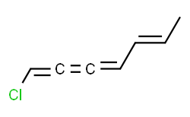
C₇H₇Cl
5-chloro-5-methyl-1,3-, heptadiyne
Benzyl chloride
7-chloro-3,5-heptadien-1-yne
7-chloro-1,3-heptadiyne
7-chloro-1,5-heptadien-3-yne
1-chloro-1,2,3,5-, heptatetraene

